Slide 1
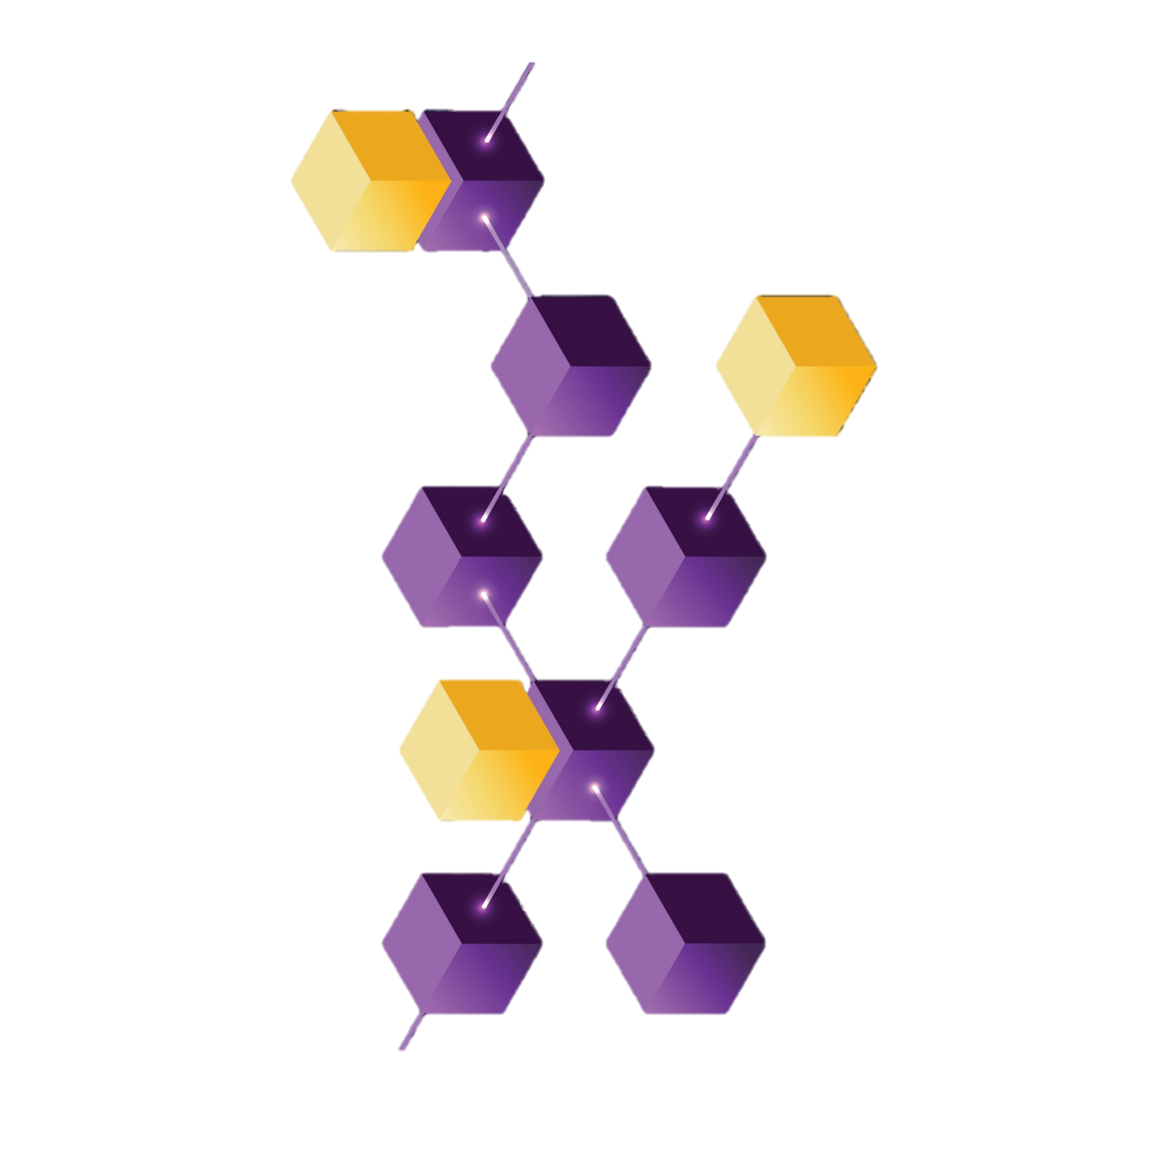
COMPUTER NETWORKS
FINAL PROJECT

Slide 2
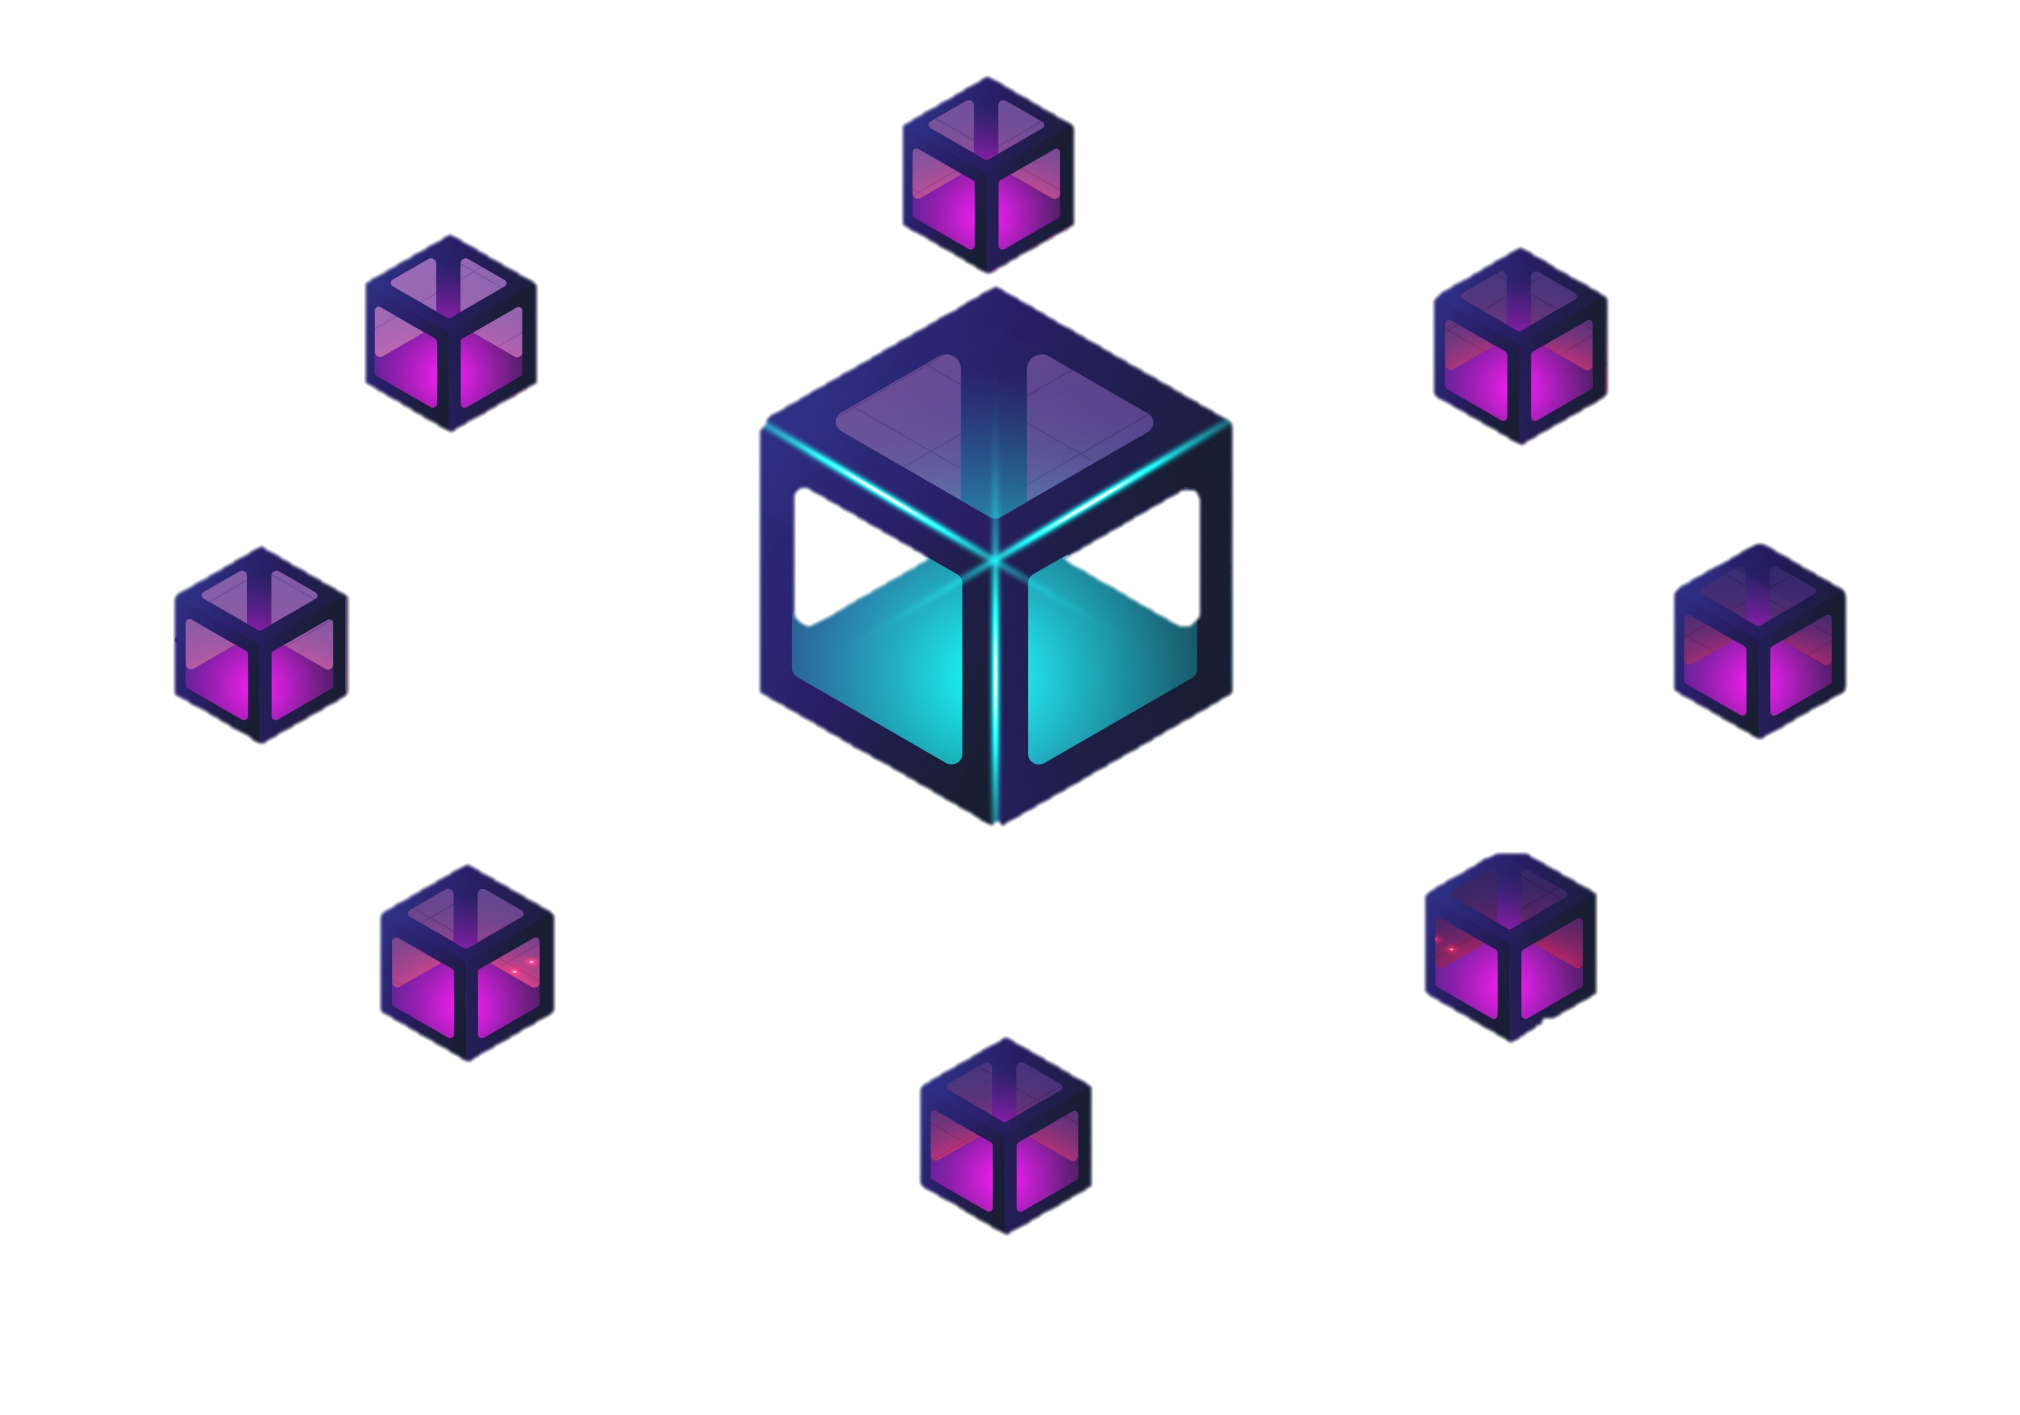
What is the project?
We're crafting a networking model using blockchain technology, drawing inspiration from the principles that power cryptocurrencies. Our project embraces the security and decentralization found in popular cryptocurrencies, bringing those benefits to our innovative network design.

Slide 3
MOTIVATION
Addresses critical issues in data security, transparency.
2. Aligns with emerging technological trends
Provides a platform for hands-on learning, innovation, and potential real-world impact.
4. Inspired from the Satoshi Nakamoto’s Bitcoin paper .

Slide 4
What is blockchain?
A blockchain is a distributed ledger with growing lists of records (blocks) that are securely linked together via cryptographic hashes.

Slide 5
System Architecture
Node that does transaction is CLIENT.
Node that does proof of Work and creates block is MINER
Every node stores it’s copy of block chain.

Slide 6
CLIENTS :
MINERS :
- Initiates transactions
- Receive transactions
- Stores the Block in blockchain
using its previous hash
-Resolve conflict
- Receive Transactions
- Create blocks
- Solve the hash puzzle
- Send the created block

Slide 7
What is a Block and How it is created?
- Block contains : Previous block hash , Transactions, Current Hash , Nonce
- First Block : Genesis Block
- Connected using previous hash values
- For adding use Consensus mechanism
- Miners keep changing the nonce to get the hash lower than the difficulty threshold.
-After achieving the required difficulty level miner creates a valid block.
Previous block’s hash
Transactions
Current hash value

Slide 8
WORKING
MODEL OF
OUR SYSTEM

Slide 9

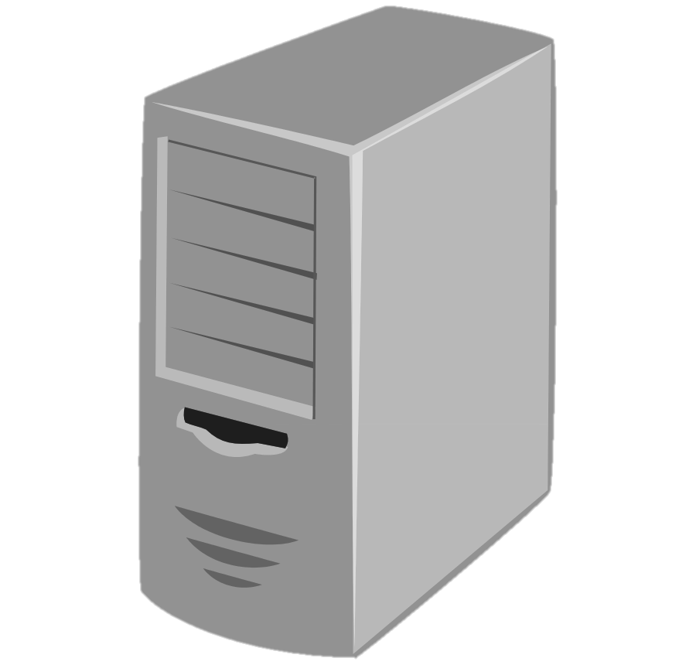
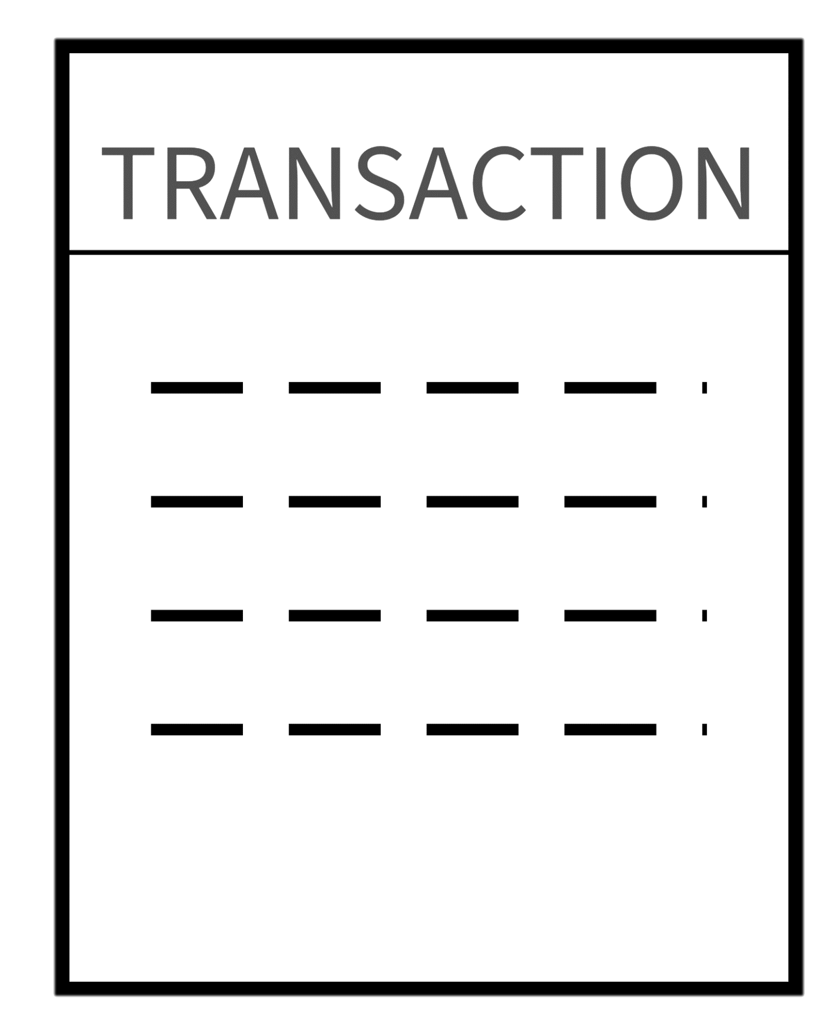
1
2
(private key )
(public key )
Client
Initiating
transaction
Joining
network
4
3
Miner
broadcasting
block
Which miner
will get to
broadcast?

Slide 10
Block getting added to the Block Chain
Previous block’s
hash
Transactions
Current hash value
Previous block’s
hash
Transactions
Current hash value
Previous block’s
hash
Transactions
Current hash value
(New Block)

Slide 11
11
1
2
Client
Initiating
fake
transaction
Miner
broadcasting
fake
block
3
When the fake block and upcoming authentic block end up having same previous hash value, there will be BRANCHING

Slide 12
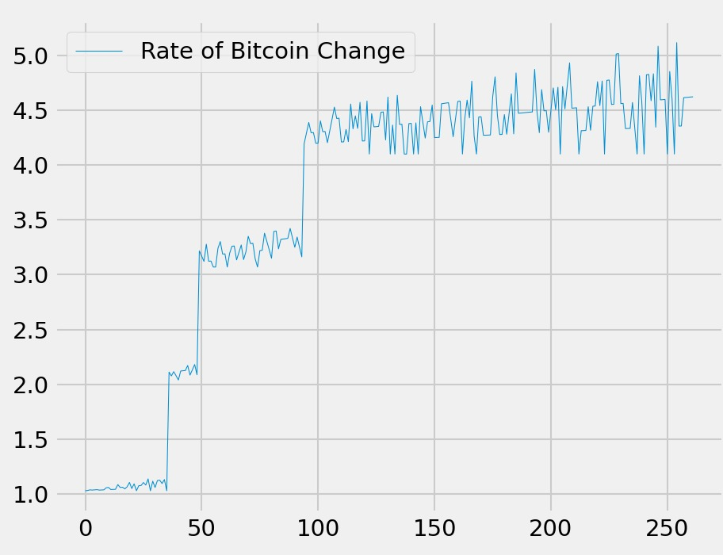
While all this goes on, the currency value
will keep getting updated by the server

Slide 13
References
Original Bitcoin Paper: https://bitcoin.org/bitcoin.pdf
Future of Crypto: https://www.youtube.com/watch?v=5-rCKo4CBgM
Live Data Analysis: https://youtu.be/Ercd-Ip5PfQ?si=j3tDxi7pheNUvMc7
But how does bitcoin actually work?: https://www.youtube.com/watch?v=bBC-nXj3Ng4
How does a blockchain work - Simply Explained: https://www.youtube.com/watch?v=SSo_EIwHSd4&t=114s

Slide 14
PROJECT BY
GROUP NO 10​
SAMPATH​
VIVEK​
SRIRAM​
SNEHA​
AKRITI​
TANUSHREE SINGH
THANK YOU

